Slide 1
Methods and Measurement Results of Digital Trade Measurement and Forward Thinking
Jia Huaiqin
Prof. of Economic Statistics, University of International Business and Economics
Minister of The Academic Committee of Statistical Society for Foreign Economic Relations and Trade of China
Expert of National Digital Trade Expert Group

Slide 2
I. Digital trade measurement: challenges of the times, opportunities for China
II. A review of foreign and domestic research on digital trade measurement
* Proposal of method of integration ratio and duality-and-three-rings framework
III. China's existing digital trade measurement practice and its measurement results
IV. Deep thinking and comments

Slide 3
1.1 What is digital trade?
Communication services (including telecommunication services, Internet services, satellite services and other communication services)
① A new type of trade formed by the paid cross-border flow of digital technology products. Digital commercialization
Computer services (including basic software services and application software services)
Digital trade is the way the digital economy operates in the field of international trade
Information service (including information services, information technology services, cloud computing, etc.)
Digital content (including animation, film and television, music, games, publication, etc.)
② The change of trading ways and the promotion of trading contents brought about by the empowerment of traditional trade by digital technology. Commerce digitalization
The so-called "own flow" in the negotiation of international digital trade rules also involves digital media (including search engines, social media platforms, news media, etc.), but the provision of these services is often not accompanied by an obvious remuneration.
Digitally enabling realizes the change of trading way
Digitally enabling realizes the promotion of trading contents

Slide 4
1.2 Differences between goods trade, service trade and digital trade
Table 1
Trade category | Business content | Rules and regulations | Statistical measurement
Goods trade | Trading of tangible products | Systematic rule system which takes the General Agreement on Tariffs and Trade (GATT) as the basic framework. | Global statistical norms provided by International Merchandise Trade Statistics: Concepts and Definitions
Service trade | Trading of intangible products | Systematic rule system which takes the General Agreement on Trade in Service (GATS) as the basic framework. | Global statistical norms provided by Manual on Statistics of International Trade in Services
Digital trade | Transaction of digital content Enabling the goods and services trade digitalization | No global and systematic regulations yet, and countries are pushing bilateral, plurilateral and regional digital trade rules | No global statistical norms exist yet, and the Handbook of Digital Trade only introduces the experiences and practices of various economies.
Due to the intangibility, boundlessness and full-time nature of digital content trade and digitally enabled trade, it is much more difficult to measure than traditional trade, and therefore the WTO has called it a "challenge of the times".

Slide 5
1.3 Digital trade measurement: challenges of the times, opportunities for China
Looking back at the beginning of China's integration into the international economic system, China lagged far behind the developed economies in terms of both trade scale and trade structure, and had to catch up. In the rules system, the GATT has long existed, and then formally established the World Trade Organization. As a newcomer, China can only "follow the existing international rules", there is little room for bargaining.
In international trade statistics, International Merchandise Trade Statistics: Concepts and Definitions has been implemented since 1970, and China has to reform its own statistical indicator system and data collection method for trade in goods according to its spirit in order to be in line with international standards. Even for the Manual on Statistics of International Trade in Services, which was implemented in 2002, China was not involved in the drafting of its first draft but was only invited to participate in the presentation of the manuscript for the Asia-Pacific region.
As far as the tide of digital trade is concerned, China and other economies are basically involved in synchronization. With a large scale on digital trade business, China has ranked among the major economies, especially cross-border e-commerce, which has unique advantages and great influence. The non-existence of uniform international rules and norms for digital trade measurement is leaving time and space for China to participate in the same way as other economies. In short, China faces good opportunities in all aspects of digital trade today, including business development, rule making and measurement methodology development.

Slide 6
In the process of moving from trade nation to a trade powerful nation, digital trade is a rare opportunity and a powerful grip. Answering the challenge of digital trade measurement in the international community with innovative thinking and scientific and pragmatic methods is the key to China's development of digital trade.
The openness and growth gives room for China to participate in its compilation and revision of the Handbook of Digital Trade.
The main members of the expert group for the preparation of the manual are from several major international organizations, and also include experts from several WTO members.
The editor-in-chief's speech mentioned the participation of three Chinese Customs officers who were involved in the compilation from the perspective of goods trade statistics (the speech mentioned China Customs’ Cross-Border E-Commerce Information System, hereinafter referred to as CBEIS).
No Chinese experts have participated in the statistics of trade in services. However, the development of digital trade measurement methods in China is pending the joint efforts of government authorities, social research institutions, and universities.

Slide 7
Concept difference and different measurement thinking of digital trade
WTO-OECD:
Wide caliber, three-dimensional architecture
Handbook of Digital Trade (2020)
Three reports of USITC on digital trade (2013, 2014, 2017)
UNCTAD & BEA:
Narrow caliber, BOP single dimension
Digitally-deliverable services (2018)

Slide 8
USITC definition of digital trade
Two reports, Digital Trade in the US and Global Economies, July 2013 and August 2014. The third report, Global Digital Trade 1: Market Opportunities and Key Foreign Trade Restrictions, August 2017.
1. "Digital trade refers to U.S. domestic commerce and international trade in products and services delivered via the Internet."
2. Digital trade is “domestic commerce and international trade in the US where the Internet and Internet-based technologies play a significant role in the ordering, production, and delivery of products and services.”
3. Digital trade refers to "products and services delivered by companies in any industry through the Internet, and related products such as smart phones and Internet sensors. It includes the submission of e-commerce platforms and related services, but does not include the sale value of tangible items ordered online, nor does it include tangible goods with digital counterparts (such as books, movies, musics and softwares burned in CDs or DVDs).”
There are three key statements in the report: the first is about the submission method, which must be submitted via the Internet; the second is about the object of transaction, including products and services; and the third is about the territory of the transaction: it refers to both domestic business in the United States and international trade.
The report broadens the concept of digital trade to include tangible goods ordered online and produced physically, paper books with digital counterparts and softwares, musics, movies and CDs in hard copy.
The report is exclusively dedicated to international trade. Basically, it is reduced to the category of the first definition, which only increases the platform service value of e-commerce and the digital hardware products associated with online delivery.

Slide 9
In 2012, U.S. experts proposed two concepts with the same connotation: digitally-enabled services and ICT-enabled services (ICT is an acronym for information and communication technology), defining them as "services in which digital information and communication technology plays an important role in cross-border trade.
—— In June, 2012, Overview of Contemporary Business of U.S. Department of Commerce published articles written by Maria Borga and Jennifer Koncz-Bruner.
In 2016, U.S. experts attempted to account for digital trade imports, exports, and the trade balance in the services sub-item of the existing balance of payments. It divides digital trade into ICT services, potential ICT-enabled services and non-potential ICT-enabled services.
The word "potential" is added in front of "ICT-enabled services" because data from ICT-enabled services cannot be directly captured in the balance of payments data collection process, but can only be classified according to the potential application of ICT in the provision of the service "potential" and "non-potential".
—— In June, 2016, Overview of Contemporary Business of U.S. Department of Commerce published Trends in U.S. Trade in Information and Communications Technology (ICT) Services and in ICT-Enabled Services written by Alexis N Grimm

Slide 10
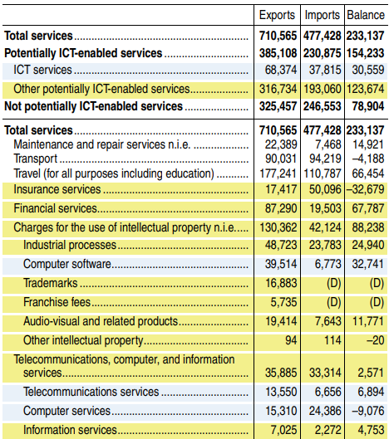
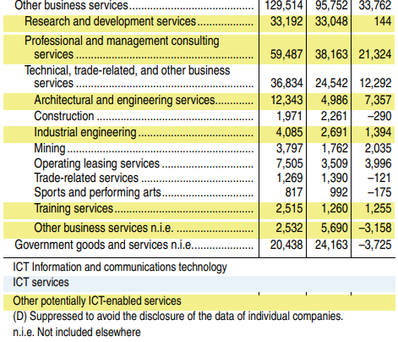
Trade in Selected Services Types by ICT and Potentially ICT-Enabled Services Categories, 2014 [Millions of dollars]
Trends in U.S. Trade in Information and Communications Technology (ICT) Services and in ICT-Enabled Services By Alexis N. Grimm，Current Business Review, May 2006, USDOC.

Slide 11
The U.S. Department of Commerce attempts to measure digital trade with a narrow-caliber.
Exports, Imports and Balance of U.S. Services Trade Classification, 2014
Unit: USD 100 million
Items | Export | Import | Balance
Total (not classified) | 7105.65 | 4774.28 | 2331.37
Modern service | 3851.08 | 2308.75 | 1542.33
Among them: ICT services | 683.74 | 378.15 | 305.59
Potential ICT-enabled services | 3167.34 | 1930.60 | 1236.74
Traditional services | 3254.57 | 2465.53 | 789.04

Slide 12
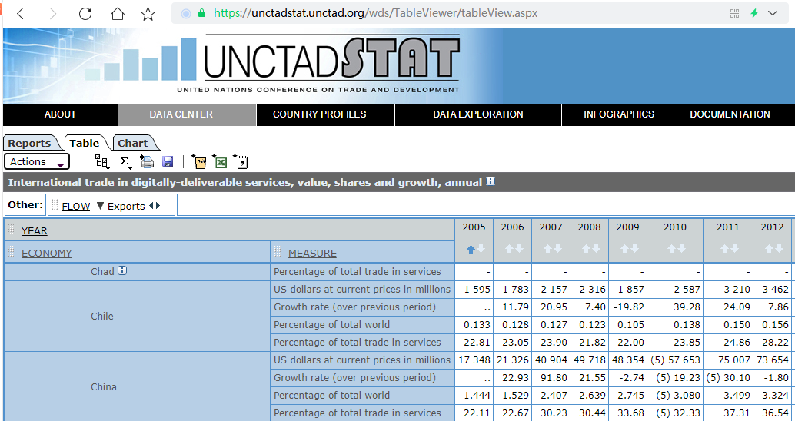
Trade in digitally-deliverable services of UNCTAD

Slide 13
Classification of digitally-deliverable and digitally-undeliverable services
Categories | Is digital delivery available
1. Processing services on physical input owned by others (hereinafter referred to as “processing services”) | No
2. Maintainess and repair services n.i. e. (hereinafter referred to as “maintainess and repair”) | No
3. Transportation | No
4. Travel | No
5. Construction services | No
6 Insurance and pension services (hereinafter referred to as “insurance services” ) | Yes
7. Financial services | Yes
8. Charges for intellectual property n.i. e. (hereinafter referred to as "intellectual property services") | Yes
9. Communication, computer and information services (hereinafter referred to as “ICT services”) | Yes
10. Other business services | Yes
11. Personal, cultural and recreament services (hereinafter referred to as "personal entertainment services") | Yes
12. Government services and goods n.i. e. | No
The above is the first level classification of services (goods) in the Extended RBOPS.

Slide 14
UNCTAD, Measurement practices in the United States and China
UNCTAD-funded comprehensive survey of experimental enterprises in three countries
Costa Rica: In 2016, about 97% of the service exports were potencial ICT-enabled services exports and 38% were actual ICT ICT-enabled exports.
Thailand
India: In 2016-17, 70% were potencial ICT-enabled services exports, while actual ICT-enabled exports accounted for 81% of the potential enabling exports.
United States: More than 50% of service exports are potencial ICT-enabled services exports.
BEA considers modifying its questionnaire to capture data on actual ICT-enabled exports
June 2018
China: ! … …

Slide 15
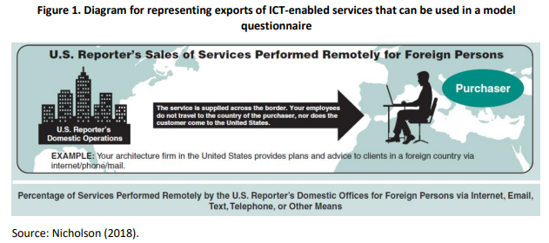
BEA's enterprise survey (included in the routine surveys on services trade)
Percentage of Services Performed Remotely by ht U.S. Reporter’s Domestic Offices for Foreign Persons via Internet, Email, Text, Telephone, or Other Means
The service is supplied across the border. Your employees do not travel to the country of the purchaser, nor does the customer come to the United States.

Slide 16
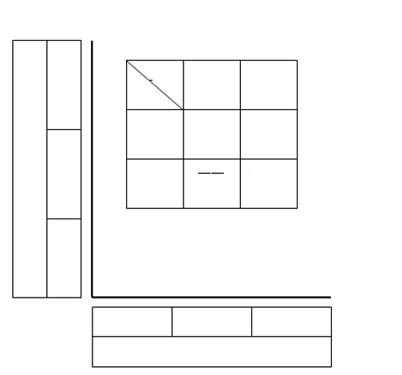
OECD's three-dimensional architecture on the concept of digital trade
Trade procedures
The first dimension--Nature
Digitally ordered?
Whether through a third-party platform (platform enabled)
Digitally delivered?
The relationship between them is "or" and "and”
The third dimension--Trader identity
B2B (Business-to-Business sales model)
B2C (Business-to-Consumer sales model)
C2C (Consumer-to-Consumer Sales model)
Digital delivery D
Purchaser
Business B
Consumer C
Supplier
Business B
B2B
B2C
Nature
Third party platform P
Consumer C
C2C
Digital order O
Goods category
Goods G
Service S
Information I
Product
The second dimension--Goods category
Good
Service
Information

Slide 17
Modified architecture

Slide 18
Basic indicators of Handbook of Digital Trade
Digitally ordered trade refers to the international trade of goods and services realized through the computer network specially designed for receiving or sending orders.
The Handbook defines digital trade as "all digitally ordered and/or digitally delivered trade".
Digitally delivered trade refers to an international trade that is delivered remotely in electronic format through special designation of computer network. "Through special designation of computer network" does not include telephone, fax, and orders made by manual input mails.
Digital intermediation platform services refer to "a paid online intermediary service in which trades can be carried out among multiple purchasers and suppliers, while the economic ownership of the goods sold or the services delivered is not held by an intermediary.”

Slide 19
Report Template Digital Trade Statistics Based on Conceptual Framework
 | Export |  |  | Import
 | Organization category |  |  | Organization category
 | Enterprise | Government | Household/non-profit organization | Enterprise | Government | Household/non-profit organization
1. Digitally ordered 2. Goods 3. Services, non-digitally delivered | ES ES/ITSS | AR | HS/CC | ES/ITSS | AR | HS/CC
4 Digitally delivered 5. Digitally ordered 6. Non-digitally delivered | ES/ITSS/ITRS | AR | HS/CC | ES/ITSS/ITRS/VAT | AR | HS/CC/MOSS
7 Total digital trade
8. Trade through DIP 9. Digital ordering 10. Goods 11. Service 12 Digitally delivered 13 Non-digitally delivered | ES＋DIP ES/ITSS/ITRS＋DIF |  | HS/CC＋DIP HS/CC＋DIP | ES/ITSS＋DIP ES/ITSS/ITRS/VAT＋DIP |  | HS/CC＋DIP HS/CC/MOSS＋DIP
Note: ES = enterprise survey, HS = household survey, CC = credit card data, ITSS = international trade in service statistics survey, DIP = data collected directly from digital intermediary platform, ITRS = international trade reporting system, MOSS = mini one-stop service, AR = administrative record, VAT = value added tax collection management record (for digital activities).
Source: Handbook of Digital Trade.

Slide 20
In 2018, Jia Huaiqin, from University of International Business and Economics, first proposed the concept of trial measurement for digital trade and the measurement method of integration ratio.
In 2020, China Industrial Control Systems Cyber Emergency Response Team (CIC) applied the integration ratio method to the central data, and for the first time completed the trial measurement for trade volume of China's actual digital delivery service.

Slide 22
Leaders of Ministry of Commerce
And ecommerce and information departments Department of Electronic Commerce and Information :
WTO put forward that the international community is facing "new challenges of Digital Trade Measurement". For handling measures, China, as a trade nation which is moving to be a trade powerful nation, should make proper contributions.
For this purpose, the following suggestions are made to the Ministry. Please see below and review.
Jia Huaiqin
The University of International Business and Economics
Prof. of Economic Statistics (Higher Education Level 2)
January __, 2017

Slide 23
Letter about suggestions on specific methods to the Department of Trade in Services of the Ministry of Commerce in February 2018
Since the current statistical system does not support the acquisition of integrated trade data in digital technology integration services, it is necessary for the competent departments to acquire the data by means other than the current statistical system, which can be in the following three ways:
⑴ Add questions about the proportion of integrated trade in various digital technology integration services in the survey questionnaire of statistical monitoring of service trade of key enterprises(the question should be easy for enterprises to understand and fill in), and focus on the percentages obtained to calculate the integrated trade volume of all digital technology integration services.
⑵ Use the ratio of the added value of digital economy in service industries to the whole industry published by CAICT in 2016 to calculate the integrated trade value of all digital technology converged services.
⑶ Build a mathematical model to calculate the integrated trade value of various digital technology converged services.
The above three methods can be used alone or in combination.
The key is to calculate the integration ratio.

Slide 24
IV. Suggestions for conducting in-depth research on digital trade and its measurement
The report of the 19th CPC National Congress proposed to build "Digital China" and to "expand foreign trade, develop new modes of trade, and promote the construction of a strong trading country". Digital trade provides an excellent opportunity for us to build Digital China and expand foreign trade, which must be grasped tightly to achieve the expansion of China's foreign trade categories and qualitative improvement. The key to promoting digital trade lies in the clear understanding and urgent expectation of industry and political circles. Therefore, it is necessary to carry out in-depth academic research and countermeasure research on digital trade.
1. Suggestions for academic research
Research should be carried out from digital trade rules and digital trade measurement. Research state should especially be changed for the current hot rules (relative) and cold measurement (absolute). Measurement method is the premise of quantitative description and demonstration of object state. In terms of digital trade, it is now important to develop measurement methods. Academic journals should pay attention to the publication of research results in this field.
2. Suggestions for relevant government departments
The government departments should organize a digital trade countermeasure research group to carry out research. On the one hand, track and study the digital trade measurement methods and systems developed by international organizations and the United States; on the other hand, integrate domestic business statistics resources such as E-commerce statistics and service trade statistics to carry out China's own research on digital trade statistics methods and systems.
In view of the complexity of the issue, the composition of the countermeasure research team should be trans-departmental (trans-ministerial and trans-ministerial departments) and experts should be recruited from universities and research institutions.
The government departments should keep special contact with the international organizations that carry out this research, so that China can retain the right to participate and have influence in the international development of digital trade measurement methods and systems.
--Taken from Jia Huaiqin, Liu Nan. Review and suggestions on the research of digital trade and its measurement — based on the literature review at home and abroad, China Economic Statistics Quarterly, 2018(01).

Slide 25
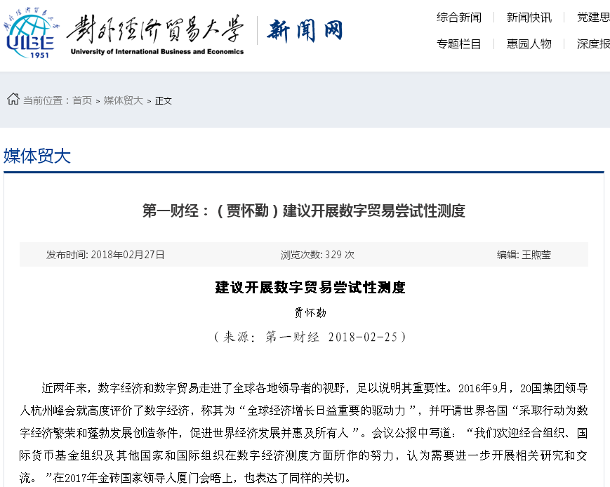
Comprehensive news
Express News
Thoughts on party building
News
Comprehensive news
Special topic
People in Huiyuan
Depth reports
Current position: Home > Media of the University > Text
Media of the University
First financial news: (Jia Huaiqin) suggested to carry out trial measurement for digital trade.
Release date: February 27th, 2018
Visitors: 329
Edited by: Wang Xuying
Carry out trial measurement for digital trade
Jia Huaiqin
(Source: CBN February 25, 2018)
In the past two years, digital economy and digital trade have entered the vision of leaders around the world, which is enough to illustrate their importance. In September 2016, G20 leaders spoke highly of the digital economy in Hangzhou Summit, calling it "the increasingly important driving force of global economic growth", and called on all countries in the world to "take actions to create conditions for the prosperity and vigorous development of the digital economy, promote the development of the world economy and benefit everyone". The communique of the Summit stated: "We appreciate the efforts made by OECD, IMF and other national and international organizations in the efforts of digital economy measurements, and believe that further research and exchanges are needed.” The same concern was expressed at the 2017 meeting of BRICS by leaders in Xiamen.at the 2017 BRICS leaders meeting in Xiamen.

Slide 26
Jia Huaiqin, Liu Nan. Review and suggestions on the research of digital trade and its measurement — based on the literature review at home and abroad, China Economic Statistics Quarterly, 2018(01).
Fang Yuanxin (China Industrial Control Systems Cyber Emergency Response Team). An exploratory analysis of the development of digital trade in China — based on the conceptual framework and indicator system of OECD-WTO. Journal of Customs and Trade, 2000(05).
Gao Xiaoyu, Jia Huaiqin, Fang Yuanxin, Wang Mengzi. Integration ratio method of digital trade measurement: from conception to actual measurement. Modern Science, 2021(10).
Jia Huaiqin, Gao Xiaoyu, Xu Xiaojuan, Fang Yuanxin. Exploration on conceptual framework, indicator system and measurement method of digital trade measurement. Statistical Research, 2021(12).

Slide 27
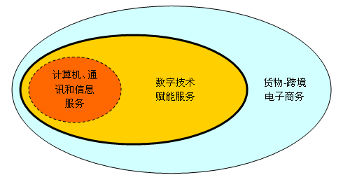
Jia Huaiqin's "Duality-and-three-rings" Digital Trade Indicator Framework
Computer, communication and information services
Digital technology enabled services
Goods—cross-border E-commerce

Slide 28
It should be pointed out that in theory, the transaction objects of E-commerce include goods and services. While, objects of the cross-border E-commerce only refer to goods in business practice, especially in the management of cross-border E-commerce by Chinese customs. However, the Cross-border E-commerce Standard Framework (June, 2018) of the World Customs Organization only uses the expression "cross-border E-commerce of tangible goods" in the first sentence of the foreword, and directly use "cross-border E-commerce” in other contexts.

Slide 29
According to the explanation of the "duality-and-three-rings” framework, the following definitions are made for digital trade:
Digital trade is the cross-border trade which is transformed from and enabled by digital technology.
Trade in the definition limit to cross-border trade between resident units and non-resident units of an economic entity. At present, there is no possible condition for obtaining the data of domestic transactions in the host economic entity carried out with foreign commercial presence. UNCTAD's survey of digital technology empowerment services excludes three delivery modes: consumption abroad, natural person presence and foreign commercial presence. The digitally delivered trade of the Handbook accepts UNCTAD's caliber, and states that measuring by four delivery modes is not a recent consideration.
The definition of transformed from digital technology and enabled by digital technology correspond to digital commercialization and commercial digitalization respectively. As for the latter, if transaction of enabled by digital technology can be made online, it corresponds to the category of UNCDAT digital deliverable services. If enabled by digital technology extends to online ordering, it can cover goods—cross-border E-commerce and services—digital trade.

Slide 30
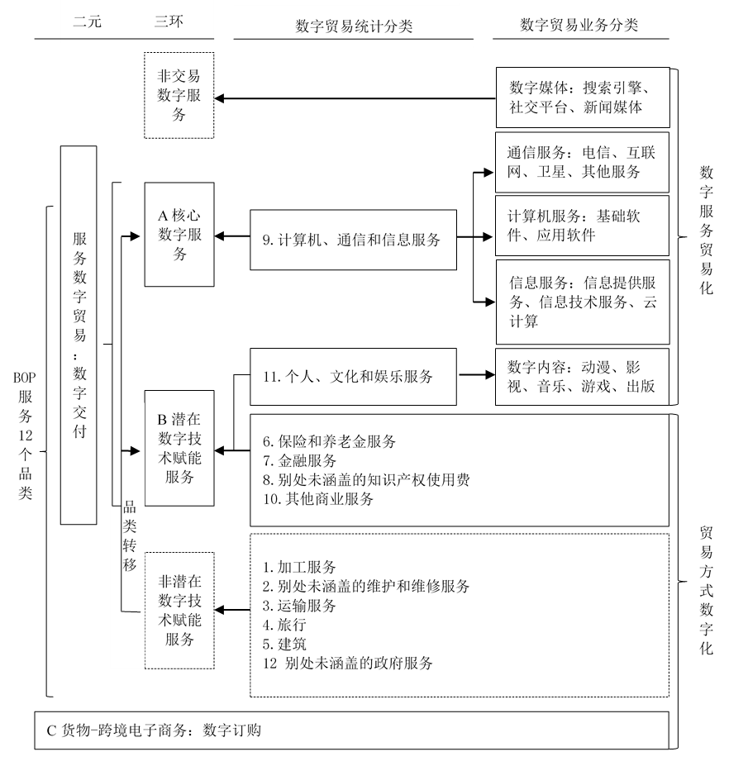
Duality
Three-rings
Classification of digital trade statistics
Classification of digital trade business
Non-trade digital service
Digital media: search engine, social platform and news media
Correspondence between EBOPS 12 service categories and those in the "duality-and-three-rings" framework
Communication services: telecommunication services, Internet services, satellite services and other communication services
Digital service commercialization
A core digital services
Computer services: basic software services and application software services
Digital Trade in Services: Digital Delivery
9. Communication,computer and information services
Information service: information services, information technology services and cloud computing services
12 categories of BOP services
11. Personal, cultural and recreament services
Digital content: animation, film and television, music, games and publishing
B Potential digital technology enabled services
6 Insurance and pension services
7 Financial services
8. Intellectual property royalties n.i.e.
10. Other services
Trade mode digitalization
Category transfer
Non-Potential digital technology enabled services
1. Processing services
2. Maintenance and repair services n.i.e.
3. Transportation services
4. Travel
5 Buildings
12 Government services n.i.e.
C cross-border E-commerce: digital ordering

Slide 31
Jia Huaiqin's trial measurement suggested the response of the China Industrial Control Systems Cyber Emergency Response Team. (hereinafter referred to as CIC)
The enterprise questionnaire survey of the platform database of the Team's integration of industrialization and informatization (hereinafter referred to as two-oriented integration) is aimed at enterprises in various enterprises of the secondary industry, and also covers the primary industry and the tertiary industry. Among them, the service industry questionnaire covers the data of 1630 service enterprises in 32 provinces and cities. The questionnaire contains two pairs of four questions that are directly related to the integration ratio, namely, gross sales and online sales of enterprises, total purchases of enterprises and online purchases of enterprises.

Slide 32
In view of the fact that enterprises usually don't distinguish between domestic and overseas sales and purchases, assuming that the ratio of overseas trades to domestic trades is equal, and the ratio of service trades to goods trades is also equal, for the investigation on sales and purchases of undifferentiated tangible goods and services, carry out the calculation in accordance with following formula:
Online overseas sales rate of enterprises
Online sales rate of enterprises
Online sales value of enterprises
Sales value of enterprises
And take the result as an alternative indicator of the integration ratio of enterprise service exports;
then carry out the calculation in accordance with following formula:
Online overseas purchase rate of enterprises
Online purchase rate of enterprises
Online purchase value of enterprises
Purchase value of enterprises
And take the result as an alternative indicator of the integration ratio of enterprise service imports.

Slide 33
2019 Actual digitally-delivered amount of China (service) digital trade import and export
Category | Export |  | Import |  | Import and export
 | Integration ratio (%) | Actual delivery amount USD 100 million) | Integration ratio (%) | Actual delivery amount (USD 100 million) | Actual delivery amount (USD 100 million)
Insurance and pension services | 48.1 | 23 | 49.3 | 53.1 | 76.1
Financial service | 30.3 | 11.9 | 36.8 | 9.1 | 21
Intellectual property royalties not covered elsewhere | 47.4 | 27.2 | 32 | 173.6 | 200.8
Communication, computer and information services | 100.0 | 538.6 | 100.0 | 269.0 | 807.6
Other business services | 47.4 | 347.5 | 32 | 159.5 | 507
Personal, cultural and recreament services | 57.2 | 6.9 | 46.9 | 19.1 | 26
Total | — | 955.1 | — | 693.4 | 1638.5
This is the first time that China has adopted the "integration ratio" method to test the scale of China's digital trade, and it is carried out in parallel with the survey of digitally actual delivery services conducted by experts from the US Department of Commerce, which is of pioneering significance.
Due to the limitation of the number of enterprise category samples collected by the platform database of "two-oriented integration of China", this test result is not enough to be used as an source for in-depth quantitative analysis, but enough to generally reveal the trend and proportional relationship of China's digital trade.

Slide 34
UNCTAD
Trade value of digitally-undeliverable services
Trade value of digitally-deliverable services
OECD&WTO Manual
Trade value of actual digitally-delivered services
Digitally-delivered trade
Trade value of digitally ordered services
Digitally ordered trade
Trade value of digitally ordered goods

Slide 35
“Duality-and-three-rings" framework digital trade measurement scheme, and
The measurement scope and methods of other two schemes
Main class | Secondary class | Service Trade Department of the Ministry of Commerce | Suggestions on measuring digital trade （Jia Huaiqin） | “Full-caliber” statistical and monitoring scheme for digital trade （developing）
Services | Digitally-deliverable services EBOPS Categories 6—11 | Total trade value | Comparison between actual digitally-delivered amount and trade value adjustment | Total trade value
 | Digitally-undeliverable services EBOPS Categories 1—5 and 12 | Cannot be included | Comparison between actual digitally ordered amount and trade value adjustment | Comparison between digitization amount and service trade value adjustment
Goods | Goods—cross-border e-commerce | — | Conceptually recognize | Included in statistics
 | Digital hardware trade | — | Conceptually not recognize | Included in statistics
Data Additivity |  | — | Binary list | Full-caliber summation

Slide 36
Trial Measurement results of UIBE-CIC research
Export/import amount of Chinese digital services, 2020
Digitally-deliverable services | Export integration ratio (%) | Actual delivery (USD 100 million) | Import integration ratio (%) | Actual delivery (USD 100 million) | Digitally-undeliverable services | Export integration ratio (%) | Actual order (USD 100 million) | Import integration ratio (%) | Actual delivery (USD 100 million)
6 Insurance and pension services | 51.1 | 27.4 | 53.0 | 65.4 | 1 Processing trade | 31.2 | 53.1 | 35.8 | 1.8
7 Financial services | 32.2 | 13.4 | 37.2 | 11.8 | 2 Maintenance and repair | 41.6 | 31.8 | 58.5 | 19.6
8 Charges for intellectual property | 38.7 | 33.6 | 59.8 | 224.9 | 3 Transportation services | 38.1 | 215.6 | 40.8 | 386.3
9 Communication,computer and information services | 100.0 | 607.6 | 100.0 | 329.6 | 4. Travel | 41.5 | 68.6 | 42.1 | 552.4
10 Other services | 46.7 | 349.1 | 53.8 | 271.7 | 5 Construction services | 29.8 | 74.9 | 36.9 | 30.1
11 Personal, cultural and recreament services | 62.2 | 8.2 | 55.3 | 16.6 | 12 Government services | -- | -- | -- | --
Subtotal | -- | 1039.4 | -- | 919.9 | Subtotal | -- | 444.1 | -- | 990.2

Slide 37
Trial measurement results of UIBE-CIC research
Export/import amount of Chinese digital services, 2019
Digitally-deliverable services | Export integration ratio (%) | Actual delivery (USD 100 million) | Import integration ratio (%) | Actual delivery (USD 100 million) | Digitally-undeliverable services | Export integration ratio (%) | Actual order (USD 100 million) | Import integration ratio (%) | Actual delivery (USD 100 million)
6 Insurance and pension services | 48.1 | 23.1 | 49.3 | 53.2 | 1 Processing trade | 33.0 | 64.7 | 54.0 | 1.6
7 Financial services | 30.0 | 11.7 | 36.8 | 9.2 | 2 Maintenance and repair | 41.0 | 41.8 | 48.0 | 17.8
8 Charges for intellectual property | 40.9 | 27.4 | 50.5 | 173.7 | 3 Transportation services | 31.9 | 146.7 | 33.2 | 348.3
9 Communication,computer and information services | 100.0 | 539.0 | 100.0 | 269.0 | 4. Travel | 31.9 | 110.1 | 38.0 | 954.2
10 Other services | 47.4 | 347.9 | 32.0 | 159.4 | 5 Construction services | 26.9 | 75.3 | 35.6 | 33.1
11 Personal, cultural and recreament services | 57.2 | 6.9 | 46.9 | 19.2 | 12 Government services | -- | -- | -- | --
Subtotal | -- | 956.0 | -- | 683.8 | Subtotal | -- | 438.6 | -- | 1354.9
Export/import amount of Chinese digital services, 2018
Digitally-deliverable services | Export integration ratio (%) | Actual delivery (USD 100 million) | Import integration ratio (%) | Actual delivery (USD 100 million) | Digitally-undeliverable services | Export integration ratio (%) | Actual order (USD 100 million) | Import integration ratio (%) | Actual delivery (USD 100 million)
6 Insurance and pension services | 41.2 | 20.2 | 45.4 | 54.0 | 1 Processing trade | 33.0 | 57.4 | 30.0 | 0.9
7 Financial services | 27.1 | 9.5 | 33.9 | 7.1 | 2 Maintenance and repair | 60.0 | 43.2 | 49.0 | 12.3
8 Charges for intellectual property | 36.9 | 20.7 | 35.1 | 125.0 | 3 Transportation services | 31.6 | 133.7 | 32.2 | 348.7
9 Communication,computer and information services | 100.0 | 471.0 | 100.0 | 238.0 | 4. Travel | 31.3 | 123.6 | 34.1 | 943.9
10 Other services | 40.9 | 285.9 | 30.2 | 142.8 | 5 Construction services | 22.6 | 60.1 | 33.8 | 29.1
11 Personal, cultural and recreament services | 53.5 | 6.4 | 43.7 | 14.9 | 12 Government services | -- | -- | -- | --
Subtotal | -- | 813.6 | -- | 581.8 | Subtotal | -- | 418.0 | -- | 1334.8

Slide 38
Measurement results of UIBE-CIC research
Import/export amount of Chinese digital services, 2018-2020
Year | Export (CNY 100 million) | Import (CNY 100 million) | Import and Export (CNY 100 million) | Export (USD 100 million) | Import (USD 100 million) | Import and Export (USD 100 million)
2018 | 8146.3 | 12681.4 | 20827.7 | 1231.7 | 1916.6 | 3148.3
2019 | 9614.4 | 14060.4 | 23674.8 | 1394.6 | 2038.7 | 3433.3
2020 | 10234.1 | 13177.5 | 23411.6 | 1483.5 | 1910.1 | 3393.6

Slide 39
“Full-caliber” statistical and monitoring scheme for digital trade
One administrative district (District A) conducted measurement of it’s digital trade according to the above-mentioned “full-caliber” statistical and monitoring scheme
According to the scheme, the actual digitally-delivered rate of digitally-deliverable trade (Categories 6-11) within the administrative district is almost 100%, and therefore the full amount of this service trade is included in the digital trade statistics, as revealed by the enterprise survey.
For digitally-undeliverable services (Categories 1-5 and 12), the digitalization rate of the systems "enable trade efficiency and quality improvement” was given in the survey on "the use of digital technology in service trade activities by key typical service trade enterprises". The digitalization rate then would be “complemented and cross-validated through multiple methods”.

Slide 40
Digitalization rate of District A digitally-undeliverable services, 2019
Services Categories | Digitalization Rate (%)
Construction | 27.7
Travel | 32.1
Transportation | 39.7
Maintenance and repair services | 32.0
Processing services | 22.4
Government services | 36.2
Structure ratio of District A digital trade value, 2019
 | First level ratio (%) | Second level ratio (%)
Total import and export value | 100
I. Trade value of digital goods | 16.4 | 100
I.i Cross-border e-commerce |  | 6.5
I.ii Digital hardware trade |  | 93.5
II. Trade value of digital service | 83.6 | 100
II.i Telecommunications, information and computer service |  | 9.9
II.ii Services supported by ICT technology |  | 28.6
II.iii Services enabled by ICT technology |  | 61.5

Slide 41
China Customs’ Cross-Border E-Commerce Statistics
Since the launch of the cross-border e-commerce pilot in 2013, China Customs(“Customs”) has gradually explored the formation of the current statistical system for cross-border e-commerce. The Customs statistics of cross-border e-commerce are mainly from the cross-border e-commerce management platform.
From 2021, the statistics scheme of "full-caliber cross-border e-commerce commercial activities" will be implemented. The scheme is designed as follows (Lu Haisheng, Fang Zheng, and Zhang Jiaguo, 2021): taking e-commerce platforms as the main investigation objects, by the means of combining administrative records, platform surveys and big data analysis, comprehensively count the import and export scale of cross-border e-commerce goods or articles, and accurately measure the scale ratio of multiple import and export channels, such as Customs cross-border e-commerce clearance platform, general cargo (including import preparation warehouses and export overseas warehouses), mail packages, express mail, to reflect the development of China's cross-border e-commerce business in a multi-dimensional and comprehensive manner.

Slide 42
July 13, 2021, the General Administration of Customs spokesman announced in the first half of 2021 import and export situation press conference: According to preliminary statistics from Customs, the first half of 2021, China's cross-border e-commerce sustains good development momentum in import and export trade with a trade value of 886.7 billion CNY, increasing 28.6% year-on-year. Of which, exports 603.6 billion CNY with an increase of 44.1%; imports 283.1 billion CNY with an increase of 4.6%.
Due to the innovation, openness and ambiguity of cross-border e-commerce as a new industry itself, its diversified types of models, fragmented trade batches and short chain of business processes are very different from the traditional trade industry. At present, China Customs' cross-border e-commerce data are of poor cleanliness, with incomplete information on classification indicators such as goods type, trade target countries and domestic shipping/receiving places, so it is not yet possible to provide segmented indicator data like traditional trade statistics, and the statistical system of cross-border e-commerce needs to be further improved.

Slide 43
Deep thinking and comments
— To align or not to align with international statistical norms？ How to align？
China's digital trade measurement should be aligned with international statistical norms, otherwise there will be disadvantages to the development of open economy. However, it’s not a unilateral recognition for China to align with international norms, but should be a integration between China and international norms. This means that China could also participate in the development of international statistical norms.
The manual still needs to be improved by WTO members working together with experts from international organizations.
Though China has already gained some participation in the customs system of cross-border e-commerce statistics, it still needs to be involved in the development of international norms in digital services trade statistics.
As a large digital trade country with a broad market, rich business categories and huge business value, China is fully capable of exploring digital trade statistics methods with its own characteristics and developing its theories, so as to provide Chinese solutions for international digital trade measurement for the international community to choose from.
For now, it’s the best and least troublesome concept of digitally-deliverable services that should be adopted first, with extracting relevant data from international services trade statistics.
Take a wait-and-see attitude towards the WTO-OECD manual. One is to wait and see the authority of the WTO, and the other is to wait for international organizations to release the norms of digital trade statistics.
OR
Decided by?
43

Slide 44
Deep thinking and comments — Short-term consideration (I)
Agree with the wide-caliber measurement vision of UNCTAD&BEA
Coordinated by?
Digitally-delivered trade:
i.e. digitally-delivered services
Commercial competent authorities!
Agree with the narrow-caliber measurement vision of UNCTAD&BEA
Stop at digitally-deliverable services, or extend to actual digitally-delivered services?
Commercial competent authorities!
Digitally ordered trade：
— Digitally ordered service
Commercial competent authorities!
Digitally ordered trade：
— Digitally ordered goods — Cross-border e-commerce
Customs!
Digital intermediary platform service
Trans-department!

Slide 45
Deep thinking and comments — Short-term consideration (II)
In the face of each province (municipality directly under the Central Government and autonomous region) defining the concept, connotation and extension of digital trade statistics indicators and developing their own data collection and measurement methods, what is the response at the national level?
The concept, connotation and extension of indicators, as well as the data collection and measurement methods are inconsistent among provinces!
Even if the concept, connotation and extension of indicators, as well as the collection and measurement methods are consistent among provinces, the summed results are not consistent with national level data!
Coordinated by?

Slide 46
Deep thinking and comments — Short-term consideration (III)
The General Administration of Customs needs to continue to improve and refine the statistical methods for cross-border e-commerce, in order to cover the various business activities of cross-border e-commerce and to be able to provide a statistical data with refined indicators such as the transaction subjects, the trade target countries, and the place of domestic business.
Coordinated by?
The manual proposes a digital intermediary platform service measurement that enables to consider the use of integrated customs and other survey methods to measure the platform service cost rate to estimate the platform cost service exports and imports in cross-border e-commerce transactions in general.
It can be completed by Customs itself

Slide 47
Deep thinking and comments — Medium- and long-term consideration (I)
Service Trade Department of the Ministry of Commerce proposes: digital trade takes data as the production factor, digital services as the core, and digital delivery as the feature.
According to the objects of the transaction, digital trade includes digital technology trade, digital product trade and data trade.
WTO-OECT had the idea of absorbing trichotomy of goods, services and information into their digital trade measurement framework.
Should we go beyond the existing classification of trade in services and create a new classification based on the objects of the transaction? Or…

Slide 48
Deep thinking and comments — Medium- and long-term consideration (II)
Digital economy satellite accounts compilation and digital trade multidimensional measurement reflect the relationship between SNA and sectoral statistics. Some of the data needed for national accounts have to be provided by sectoral statistics, and analyzing the problem from the perspective of the national accounts helps to clarify the scale and proportionality of the multiple indicators involved in digital trade.
The multidimensional measurement requirements proposed in the manual are not available for full implementation in the near future, and can only be used as a medium- and long-term effort goal, with relevant government departments and research institutions devoting their efforts to research.
The "Statistical Classification of the Digital Economy and its Core Industries" issued by the National Bureau of Statistics in June 2021 establishes the basic guideline and indicator system for the statistical accounting of the digital economy and lays a solid foundation for the future compilation of satellite accounts of the digital economy. However, classifying the digital economy industries is only a small step towards the quantitative understanding of the impact of digital technology on the classification of digital trade. The product classification of digital trade requires innovation based on new transaction models, taking into account various factors such as macro management, data availability and statistical efficiency. Anyway, there are various problems waited to solve, which is a long way to go.

Slide 49
Thank you!

